Slide 1
ISNS CASE STUDy
With Dr. Norbert Ketskes on Colon Cancer

Slide 2
Medical Disclaimer
The information provided is for educational purposes and is not intended as medical advice, or a substitute for the medical advice of a physician or other qualified health care professional. This is for science and educational purposes only and cannot be used in any aspect for sales or marketing. You should not use this information for diagnosing a health or fitness problem or disease. You should always consult with a doctor or other health care professional for medical advice or information about diagnosis and treatment. This is Confidential. Do not distribute—for scientific educational purposes only.

Slide 4
DR. NORBERT KETSKÉS, MD
Dr. Norbert Ketskés M.D. is one the most acknowledged gastroenterologist in Hungary, specializing in natural and organic nutritional solutions, leading the well-known Primus Labor, a private clinic offering personalized nutritional advices to its patients.
Scientific Adviser of ISNS
Medical Partner of the Hungarian Olympic Committee since 2015
Member of the Medical board of Hungarian Karate Association since 2015
Leader of the Primus Labor Private Medical Clinic since 2013
Working as a Family Doctor 1999 – 2012

Slide 5
CSISZTU ZSUZSA
Television - Presenter, Anchor, Editor, Journalist and Sports Lawyer, Sport-diplomat
Spokesperson of the Giro d’Italia Grande Partenza, (Road-Cycling World -Tour Championship)
Spokesperson of the FINA (Swimming and Waters poets World Championship)
2022 Vice-President of the Hungarian Sports Journalists’ Association
Member of the Hungarian Olympic Committee Member of the Advisory Board of the Hungarian Olympic Academy
Newly Elected Vice-President of the International Sports Journalists Association, the first female ever in the field from her homeland, and third globally since 1924 (AIPS)

Slide 6
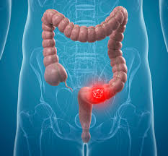
Colon Cancer
Colorectal cancer is a disease in which cells in the colon or rectum grow out of control. Sometimes it is called colon cancer, for short. The colon is the large intestine or large bowel. The rectum is the passageway that connects the colon to the anus.
Sometimes abnormal growths, called polyps, form in the colon or rectum. Over time, some polyps may turn into cancer.
Colon cancer typically affects older adults, though it can happen at any age. It usually begins as small, noncancerous (benign) clumps of cells called polyps that form on the inside of the colon. Over time some of these polyps can become colon cancers.
If colon cancer develops, many treatments are available to help control it, including surgery, radiation therapy and immunotherapy.

Slide 7
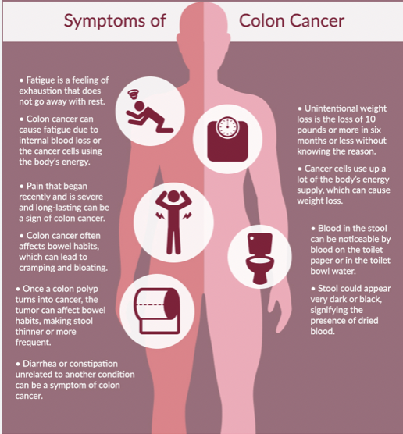
Symptoms
Colorectal cancer symptoms depend on the size and location of the cancer. Some commonly experienced symptoms include changes in bowel habits, changes in stool consistency, blood in the stool, and abdominal discomfort

Slide 8
CASE STUDY
Patient: Male
Age: 69 year old
History and test results:
Family history:
No Colon Cancer occurred
7 months ago, during a routine examination, a lesion was found on an abdominal ultrasound.
He had no complaints!
A biopsy was performed during a colonoscopy
Result of biopsy: Adenocarcinoma sigmae.

Slide 9
CASE STUDY
The tumor was surgically removed 5 months ago.
Due to the histological results, 8 chemotherapy treatments followed.
An enlarged lymph node was found in the control examinations, which showed a metastatic structure.
The patient did not consent to its histological examination.
We met for the first time after 2 chemotherapy treatments. Then the following complaints appeared as side effects of the treatment:
general weakness, diarrhea, nausea, vomiting, malaise.
Laboratory: higher WBC (white blood cells): 17,6 (range 4,8-10,8 G/L) high inflammatory parameter (CRP: 145 mg/l, normal up to 5,0) and higher liver enzyme levels: ASAT:132 (U/L) (range 0-50), ALAT:122, range (0-50), GGTP: 168, (range 8-50 U/l)

Slide 10
Conventional Treatment
In general (It depends on the histological diagnosis):
The most common treatment for early stage colon cancer is surgery. Some patients with early stage disease may also receive chemotherapy after surgery.
For patients with localized colon cancer, the five-year survival rate is 90 percent.

Slide 11
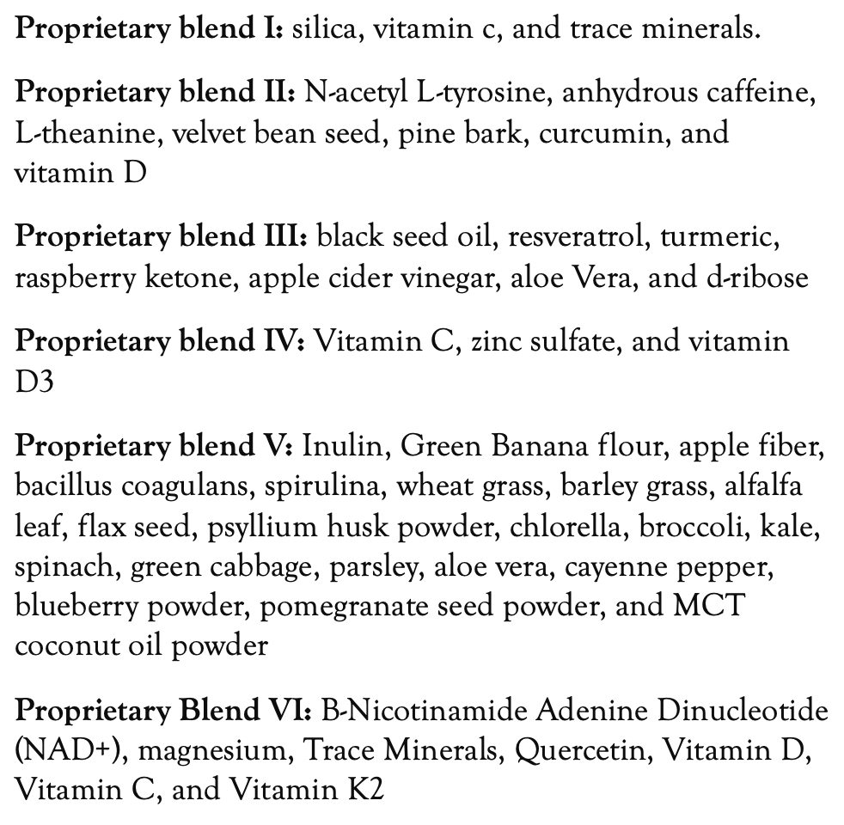
Method
PROPRIETARY BLENDS LEGEND
Proprietary blend I: 2x8 drops, morning and evening, for 3 days, then every 3 days then increased by 1-1 drops every 3 days to 2x10
Proprietary blend II: 1 in the morning for 3 days, then 2, 1 in the morning and 1 in the afternoon, then 3, 2 in the morning and 1 in the afternoon
Proprietary blend III:1 sachet in the morning for 3 days then 1 sachet in the morning and 1 sachet in the evening for 3 days, then 2 sachet in the morning and 1 sachet in the evening
Proprietary blend IV: 1 teaspoon in the morning
Proprietary blend V: 2 teaspoon in the morning and in the evening
Proprietary blend VI: 2 in the morning and 1 in the evening for 7 days, then 2 in the morning and 2 in the evening

Slide 12
Additional Proposal
A special diet based on my personal experience (more than 10 years)
Exercises to achieve a positive mental and emotional state
The patient for now is undergoing chemotherapy and my suggested complimentary treatments at Primus Labor. Summarizing the results of these combined treatments can be expected after finishing the chemotherapy.

Slide 13
Results
Laboratory: higher WBC (white blood cells): 17,6-9,2 (range 4,8-10,8 G/L) high inflammatory parameter (CRP: 145-31 mg/l, normal up to 5,0) and higher liver enzyme levels: ASAT:132-55 (U/L) (range 0-50), ALAT:122-58, range (0-50), GGTP: 168-62, (range 8-50 U/l)
Complaints have been greatly reduced
Diarrhea and vomiting have stopped
He is feeling well!
the control results are marked in red

Slide 14
References
https://pubmed.ncbi.nlm.nih.gov/34672618/
https://www.ncbi.nlm.nih.gov/pmc/articles/PMC8067874/
https://www.news-medical.net/life-sciences/NAD2b-Metabolism-in-Cancer-and-Cancer-Therapies.aspx
https://jgo.amegroups.com/article/view/47581/html
https://www.frontiersin.org/articles/10.3389/fonc.2022.881641/full

Slide 15
Thank You for Joining Us This Week!!

